Slide 1

Unit 3: Supervised Learning
Introduction, Training Set, Definition of the Classification Problem, Induction Algorithms, Performance Evaluation, Scalability to Large Datasets, The “Curse of Dimensionality”, Decision Trees.

Slide 2
Supervised vs. Unsupervised Learning
Supervised learning (classification)
  Supervision: The training data (observations, measurements, etc.) are accompanied by labels indicating the class of the observations
  New data is classified based on the training set
Unsupervised learning (clustering)
  The class labels of training data is unknown
  Given a set of measurements, observations, etc. with the aim of establishing the existence of classes or clusters in the data

Slide 3

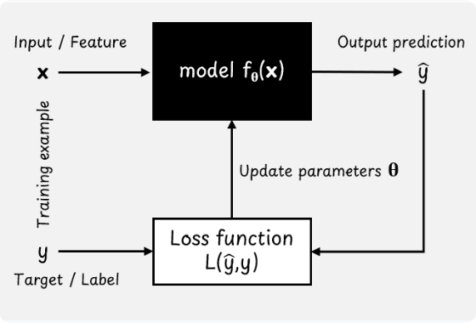

Introduction to Supervised Learning
Learning from Labeled Data
Supervised learning involves training an algorithm on a dataset containing both the inputs and the "correct answers" (labels). The model learns to map inputs to outputs.
•
Goal: Infer a mapping function f(X) → Y that generalizes to unseen data.
•
Teacher Signal: The algorithm is iteratively corrected when its predictions miss the ground truth label.

Slide 4






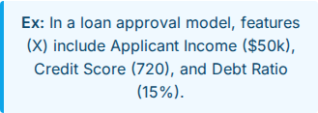


Anatomy of a Training Set
Input Features (X)
Target Labels (Y)
Instances (D)
The measurable properties or characteristics used for prediction.
The outcome variable the model is trying to predict.
Individual pairs of (xi, yi) forming the historical dataset.

Slide 5
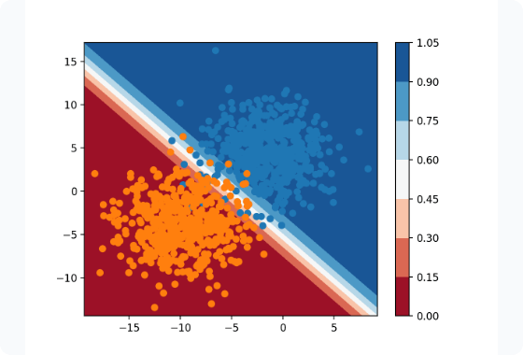

Defining the Classification Problem
Categorizing Data Points
Classification is a specific type of supervised learning where the target variable Y belongs to a discrete set of classes. The model learns a decision boundary to separate these classes.
•
Binary: Only two possible outcomes (e.g., True/False).
•
Multi-Class: More than two mutually exclusive outcomes.

Slide 6




Induction Algorithms & Inductive Bias
The Inductive Hypothesis
Understanding Inductive Bias
Induction assumes that a model that performs well on a large, representative training set will also perform well on unobserved future examples.
Every algorithm makes underlying assumptions (bias) about the target function to generalize beyond the training data. Without it, learning is impossible.

Slide 7
Induction Algorithms
It is the process of learning general rules or patterns from specific examples. In data mining and machine learning, induction algorithms learn a model from training data. The learned model can then be used to: Predict unknown values
Classify new objects
Discover relationships and patterns
Example: From previous student records, predict whether a new student will pass or fail. Basic process:
Training Data → Induction Algorithm → Learned Model → Prediction

Slide 8
Types of Induction Algorithms
1. Decision Tree Induction Builds a tree-like classification model.
Examples: ID3, C4.5, CART.
2. Rule-Based Induction Generates IF–THEN rules.
Example:
IF attendance > 75% AND marks > 50
THEN Student = Pass.
3. Regression-Based Induction Learns relationships between variables.
Used for predicting continuous values.
4. Instance-Based Induction Makes predictions based on similar training examples.
Example: k-Nearest Neighbors (k-NN).

Slide 9
Decision Tree Induction
A decision tree represents knowledge using:
  Root node – starting attribute
  Internal nodes – tests on attributes
  Branches – outcomes of tests
  Leaf nodes – final class/prediction
Example:
Attendance?
/ \
High Low
/ \
Marks > 50? Fail
/ \
Yes No
/ \
Pass Fail
Common algorithms:
  ID3 – uses Information Gain
  C4.5 – uses Gain Ratio
  CART – commonly uses Gini Index

Slide 10
General Steps of Induction
Step 1: Collect and prepare training data
Step 2: Select relevant attributes/features
Step 3: Choose the best attribute for splitting
Step 4: Divide the dataset into subsets
Step 5: Recursively repeat the process
Step 6: Stop when a suitable stopping condition is reached
Step 7: Prune the model if necessary
Step 8: Evaluate the learned model using test data
Overall:
Data → Attribute Selection → Model Construction → Pruning → Evaluation → Prediction

Slide 11
Advantages, Limitations & Applications
Advantages
Easy to understand and interpret
Can discover useful patterns
Supports prediction and classification
Many algorithms can handle large datasets
Limitations
May overfit training data
Irrelevant attributes can reduce performance
Noisy data can affect the learned model
Complex models may become difficult to interpret

Slide 12
Applications
Student performance prediction
Medical diagnosis
Credit-risk assessment
Customer classification
Fraud detection
Sales and demand prediction

Slide 13
Evaluation & Large-Scale Constraints
How to measure success and deal with the complexities of big data

Slide 15

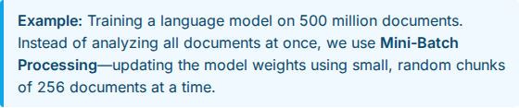
Scalability to Large Datasets
Overcoming Memory Bottlenecks
Traditional algorithms load all data into RAM. When datasets scale to millions of rows, this becomes physically impossible, requiring scalable solutions.
O(N)
Desired Time Complexity

Slide 16

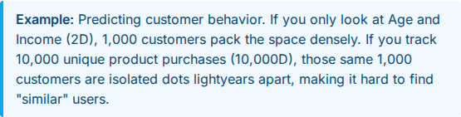
Curse of Dimensionality
Sparsity in High Dimensions
As the number of features (dimensions) increases, the volume of the feature space grows exponentially, making data instances incredibly sparse.
Distance metrics (like Euclidean distance) lose meaning because the distance between any two points becomes nearly identical.

Slide 17
Decision Trees: Mechanics
Hierarchical Structure: Consists of internal nodes (feature tests) and leaf nodes (class predictions). It recursively splits data based on rules.
High Interpretability: Unlike neural networks, trees can be read as simple IF-THEN rules, making them highly trusted in medical and financial sectors.
Overfitting Risk: A tree allowed to grow infinitely will memorize the training data, creating a branch for every single outlier. We must use "pruning" or set a "max depth".

Slide 18








Tree Splitting Criteria
Information Gain (Entropy)
Gini Impurity
Measures how much a split reduces uncertainty. The algorithm chooses the feature split that results in the purest child nodes.
Measures the probability of misclassifying a random data point if labeled according to the distribution in the node. Faster to compute than Entropy.

